Slide 1
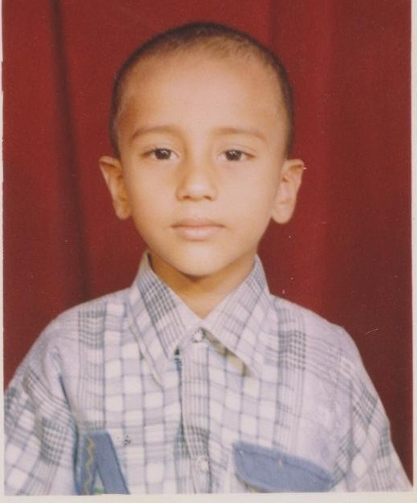
TEACH A CHILD SCHOOL SYSTEM
BEGINNING OF SUCCESS STORIES
THE FIRST PROFESSIONAL
MASTER SAIFULLAH BADAR
A STUDENT OF
TEACH A CHILD SCHOOL SYSTEM
FROM SEP 1999 TO SEP 2013

Slide 2
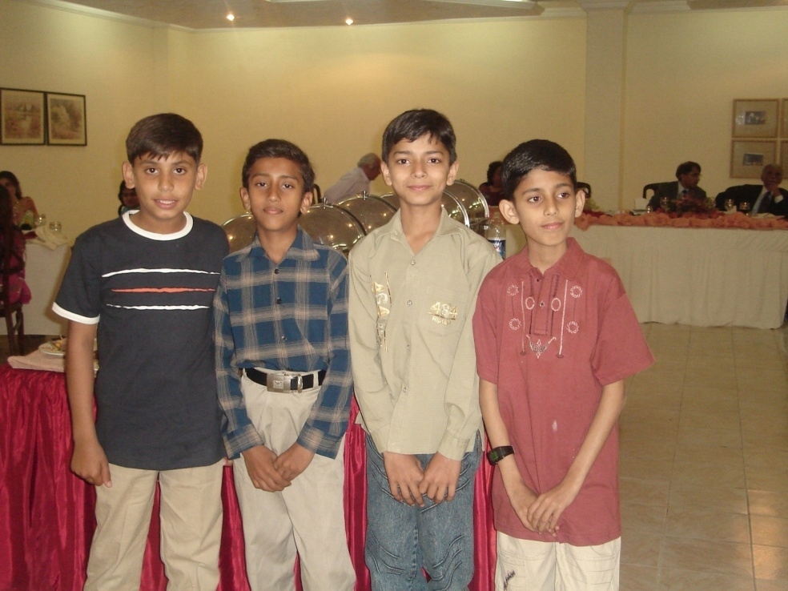
FIELD TRIP TO KHARIAN Class 5
MANGLA CANTT. 1 CORPS OFFICERS MESS 2005

Slide 3
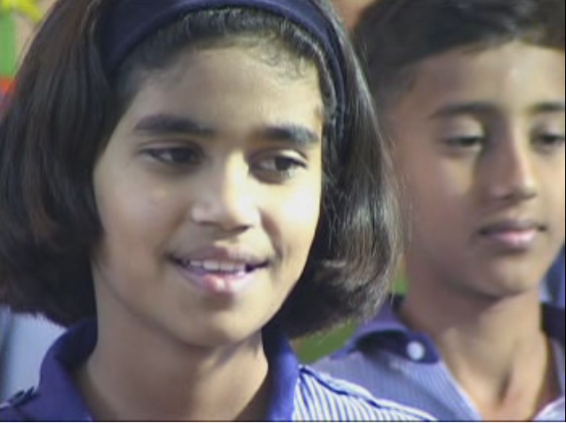
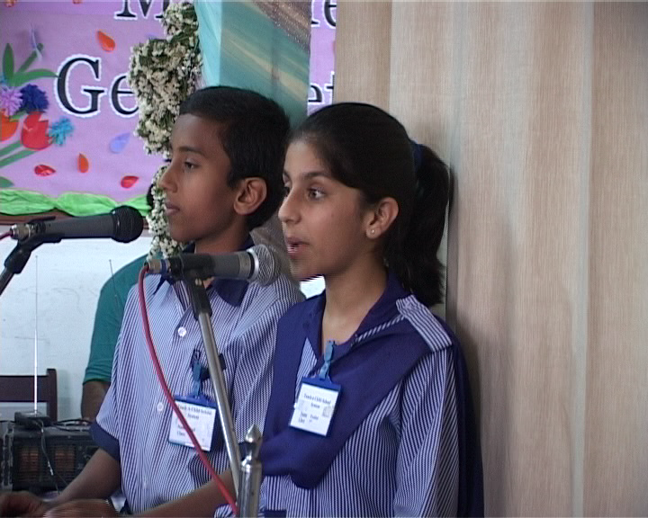
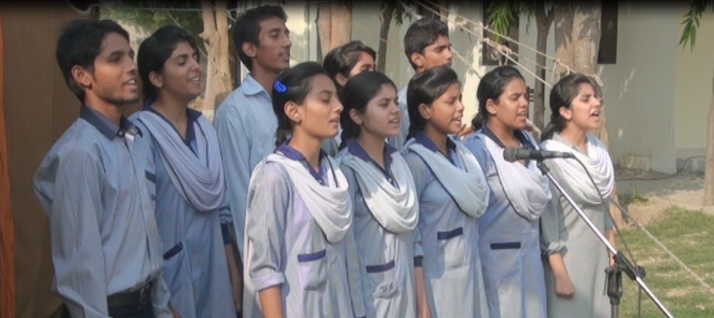
SAIFULLAH BADAR WITH CLASS FELLOW RABIA RAFIQ
SAIFULLAH BADAR & FAZEELAT ABBAS COMPERING THE ANNUAL DAY
22 SEP 2010
MASTER SAIFULLAH BADAR, CLASS 9
SAIFULLAH BADAR IN SCHOOL CHOIR

Slide 4
PARENTS, FRIEND OF TAC, VP & SAIF EMOTIONAL EXCITEMENT ON RECEIPT OF PMA CALL LETTER OCT 2013

Slide 5
TAC ALUMNI, CLASS MATES AND MENTORS BIDDING FAREWELL TO MASTER SAIFULLAH BADAR

Slide 6
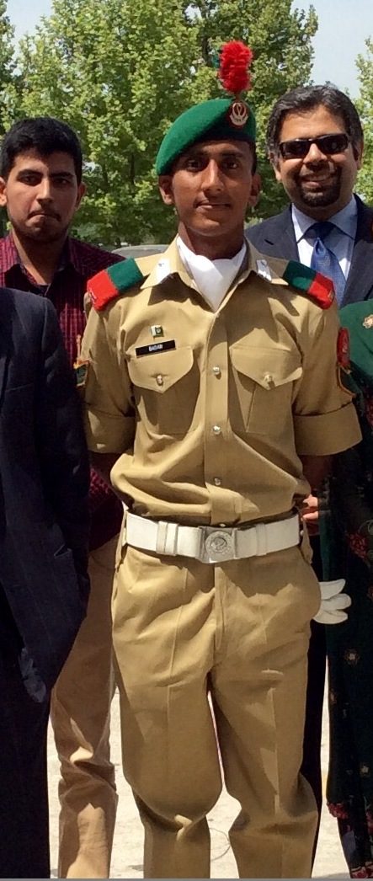
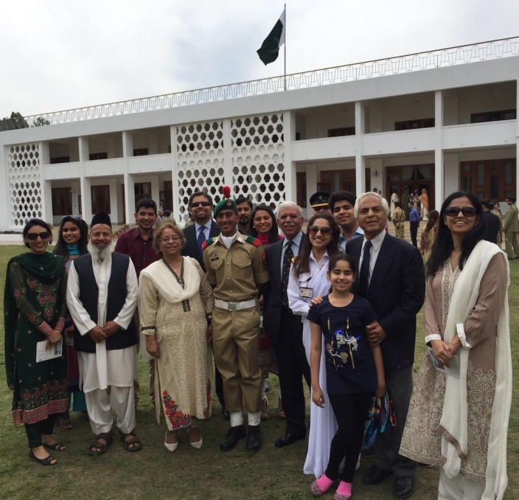
GENTLEMAN CADET SARGENT SAIFULLAH BADAR
PAKISTAN MILITARY ACADEMY
Oct 2013- Apr 2015
THE FIRST PROFESSIONAL
AFTER THE PASSING OUT PARADE WITH HIS TEACHERS ( ON LEFT & RIGHT CORNERS) , CLASS FELLOWS, FATHER ( THIRD FROM LEFT) AND FRIENDS OF TAC

Slide 7
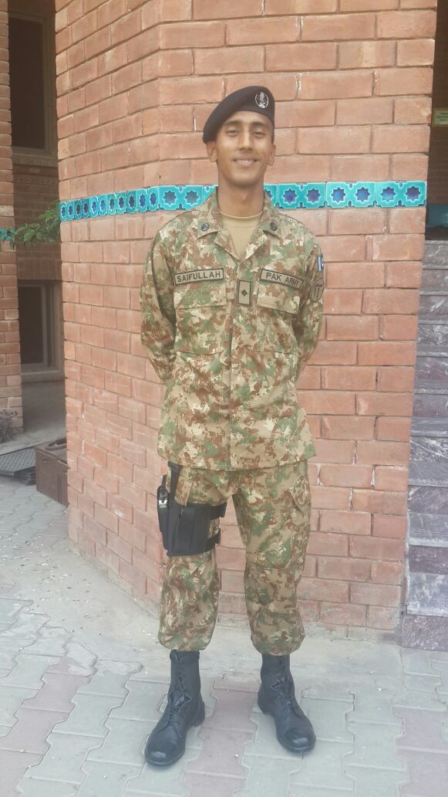
THE FIRST PROFESSIONAL
With parents, Post-commission
visit to his Alma Mater
2ND LIEUTENANT SAIFULLAH BADAR
AT HIS ALMA MATER

Slide 8
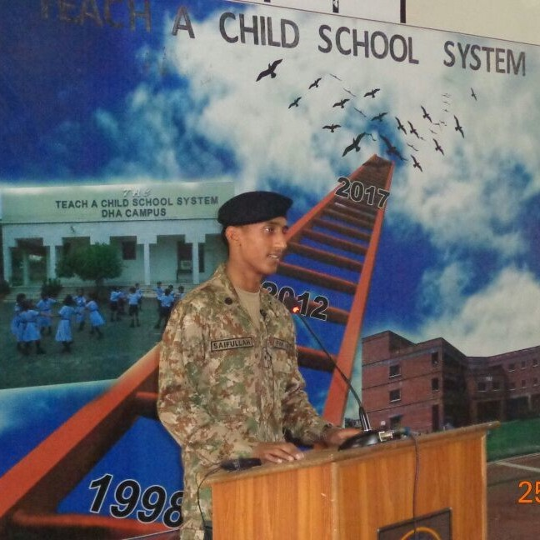
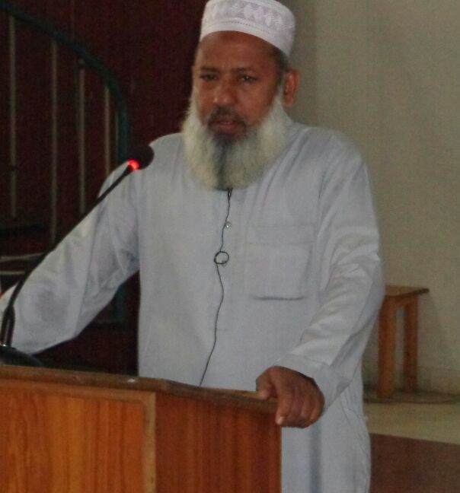
SON & THE FATHER SHARING THEIR
SENTIMENTS & THOUGHTS WITH THE
STUDENTS & TEACHERS AT TAC
ON 25 APRIL 2015
1999-2013
AT TAC
NURSERY TO PMA

Slide 9
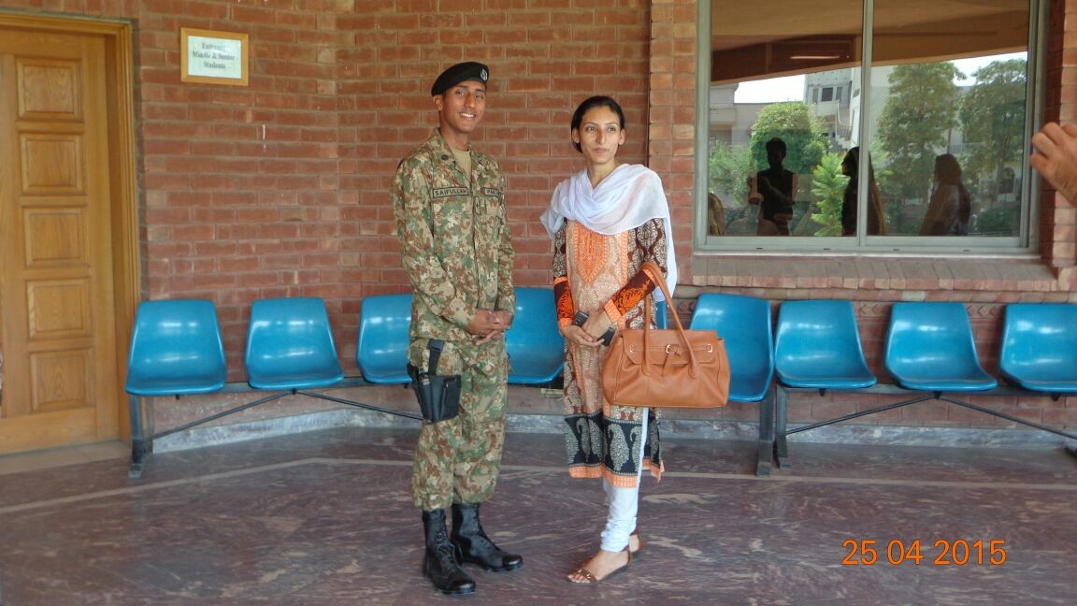
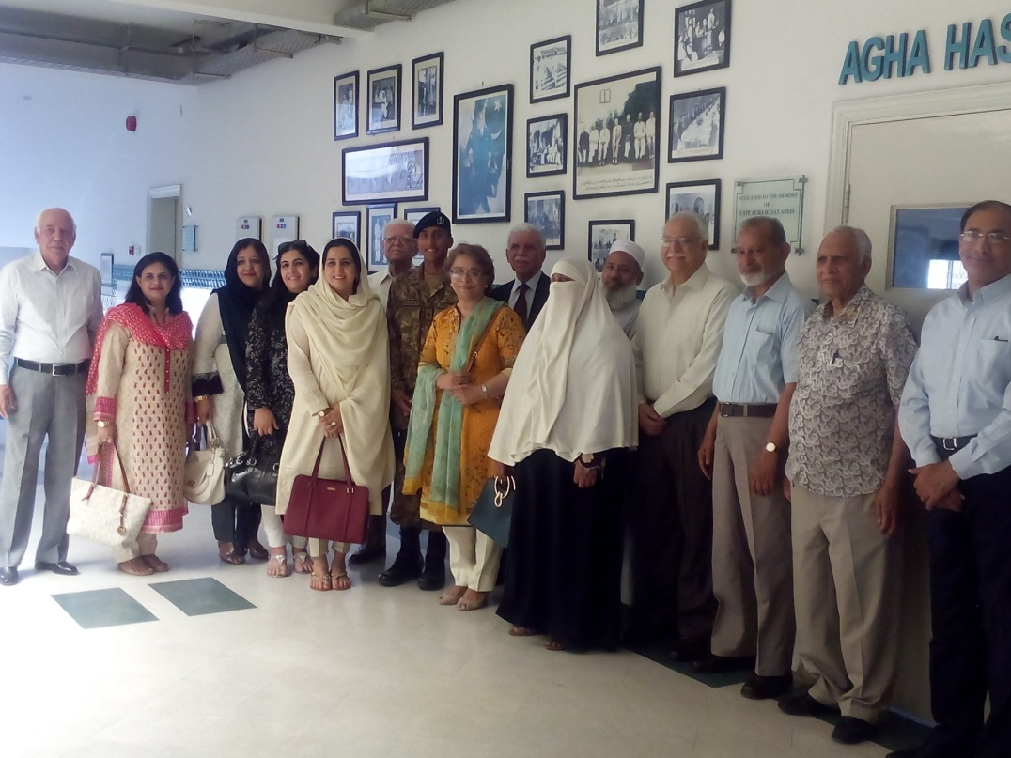
MEETING PIR FARID AHSANUDDIN, MEMBER BOARD OF GOVERNORS.
HIS ENGLISH TEACHER AT TAC, MR. AFTAB AHMED CHEEMA, IS SEEN IN THE BACKGROUND.
WITH HIS CLASS 2 TEACHER, MISS NAZIA LATIF
WITH PARENTS, VOLUNTEERS & FRIENDS OF TAC DURING HIS VISIT TO PAY RESPECT
TO HIS ALMA MATER ,
WHERE HE WAS MENTORED
FROM 1999 TO 2013, BEFORE HE JOINED
PAKISTAN MILITARY ACADEMY
IN OCT 2013, AFTER COMPLETING
14 YEARS OF EDUCATION

Slide 10
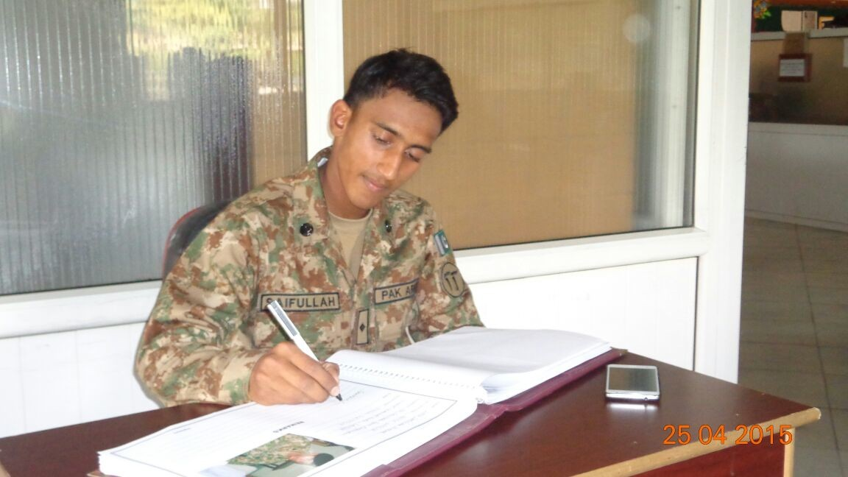
2ND LIEUTENANT
SAIFULLAH BADAR
BEING PRESENTED
A MOMENTO.
MISS ATIYA BATOOL,
HEAD OF STUDENT AFFAIRS, SEEN IN THE CENTRE.
2ND LIEUTENANT
SAIFULLAH BADAR RECORDING HIS IMPRESSIONS IN THE
VISITORS’ BOOK AT TAC
ON 25 APRIL 2015.
HE LEFT FOR KASHMORE
ON 27TH APRIL,
TO JOIN 55 CAVALRY,
AN ARMOUR REGIMENT OF THE PAKISTAN ARMY.

Slide 11
WISHING, 2ND LIEUTENANT SAIFULLAH BADAR, 55 CAVALRY, THE BEST OF SOLDIERING

Slide 12
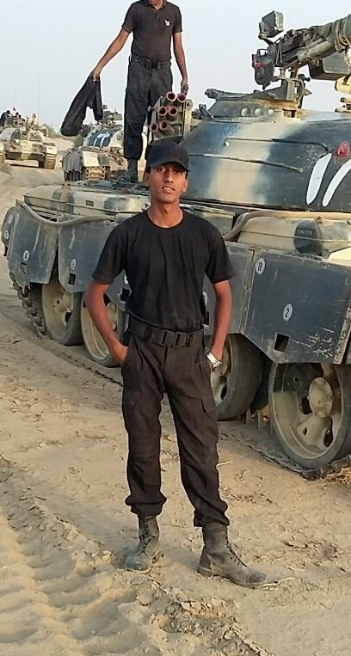
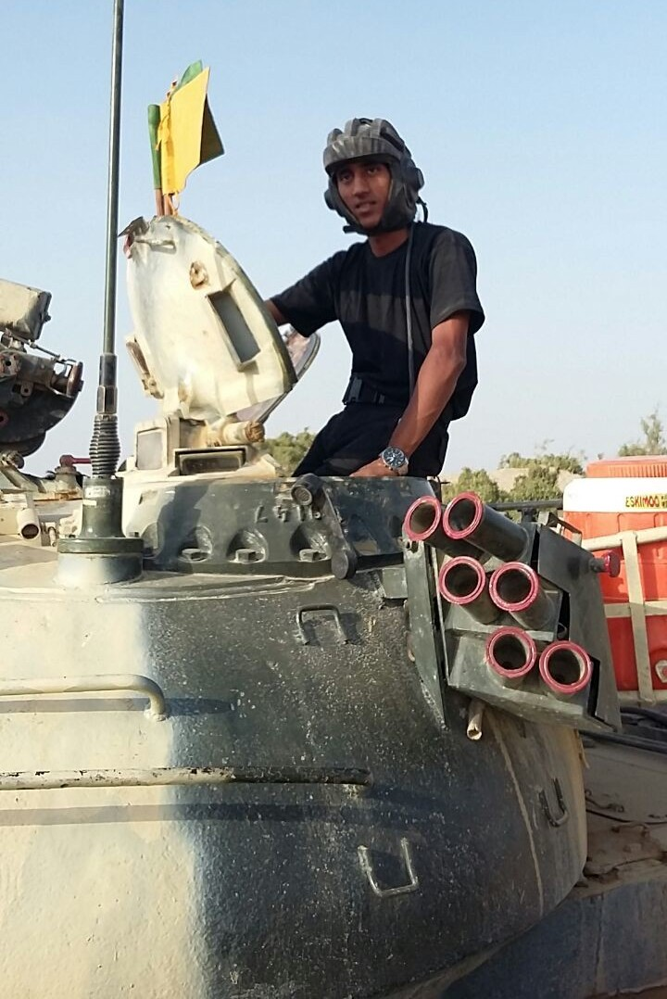
55 CAVALRY REGIMENT
A NEW BEGINNING
NEW FACES, NEW PLACES & NEW THINGS TO DO
MAY ALLAH KEEP YOU
AND YOUR COMRADES
SAFE FROM HARM’S WAY

Slide 13
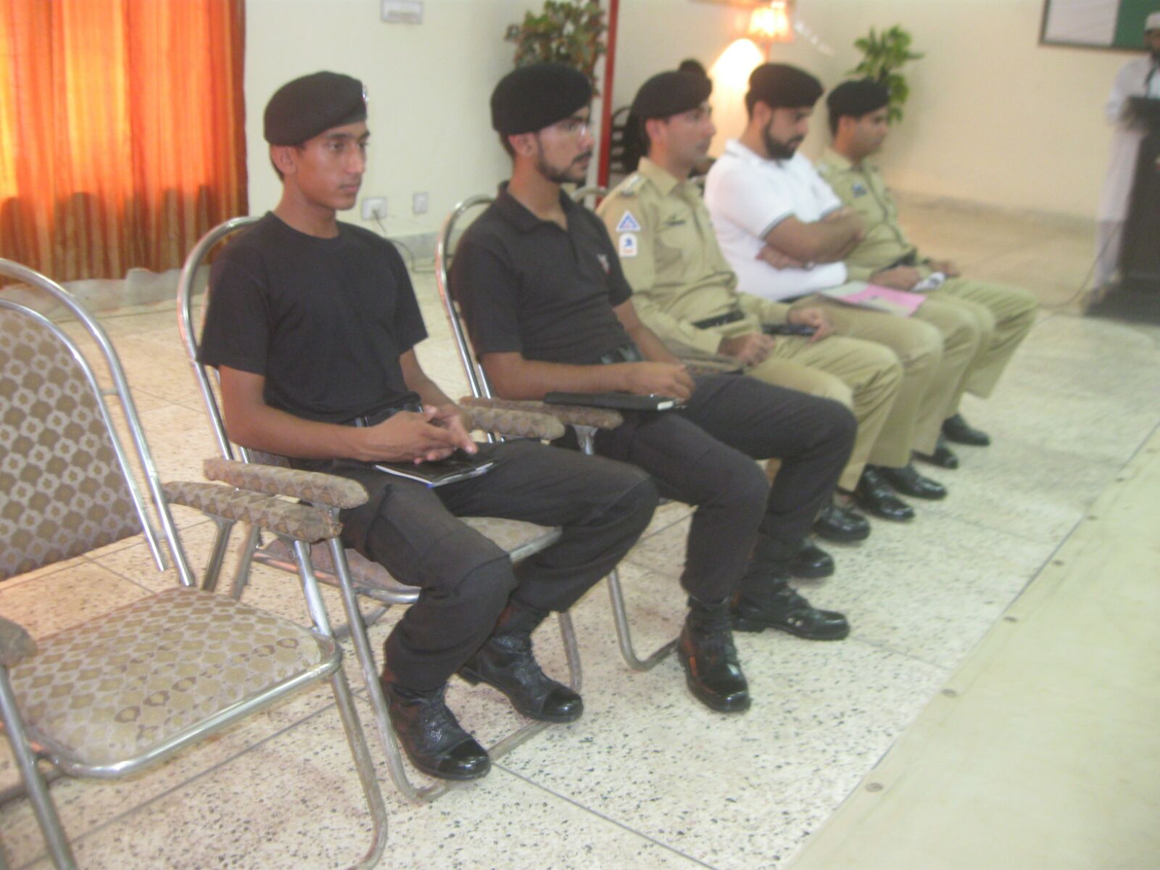
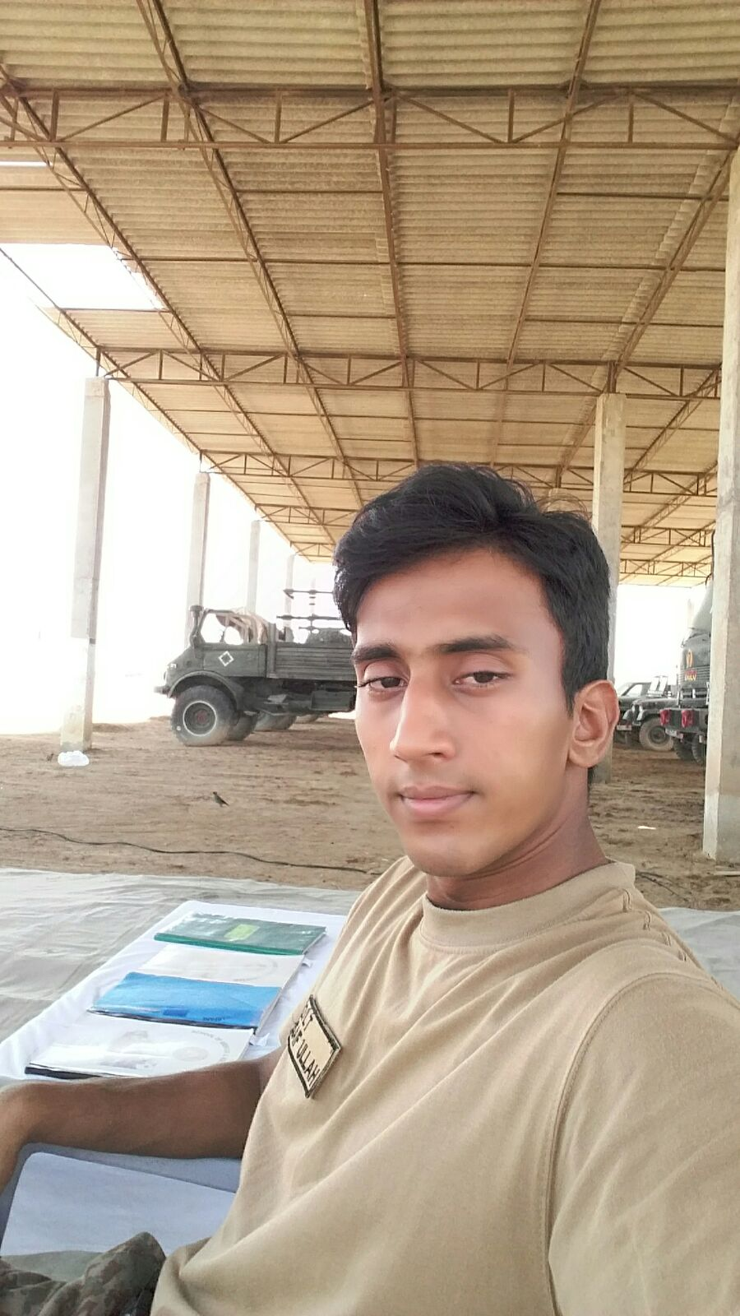
In the unit garage
Attending unit function

Slide 14
Witnessing the 14TH Aug 2015 parade

Slide 15
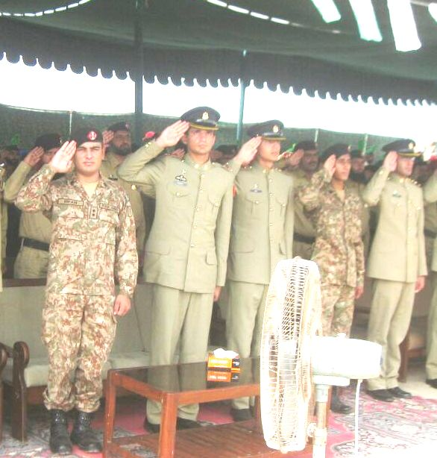
Salutation in respect of the National Anthem

Slide 16
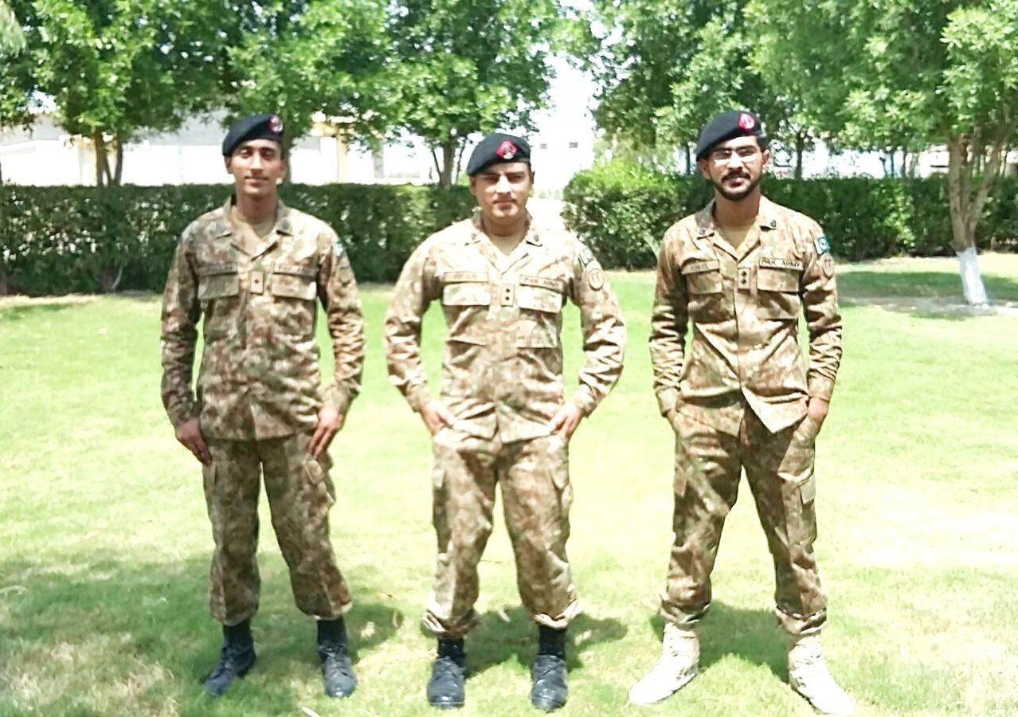
Saif With Regimental Colleagues

Slide 17
Meeting His Brigade Commander

Slide 18
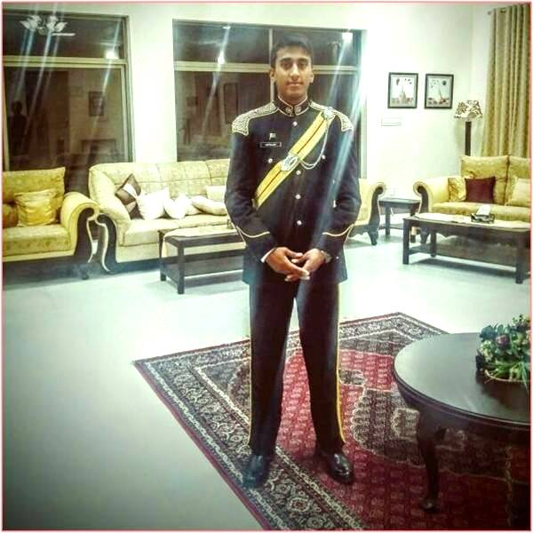
SAIF & SAIF

